Slide 1

Customer Lifetime Value Prediction
Data 606: Capstone in Data Science
Professor Darin Johnson
Presented by-
Abhinay Nagulapalli
Gauree Khapekar
Monika Arumalla
Neha Dave

Slide 2
What is Customer Lifetime Value?
Customer value or Customer Lifetime Value (CLV) is the total monetary value of transactions/purchases made by a customer with the business over his entire lifetime.
CLV helps estimate how much should a business invest in order to retain a customer.

Slide 3
Advantages
Decide how much to invest in advertising.
Decide which customers to target with advertising.
Plan how to move customers from one segment to another.

Slide 4
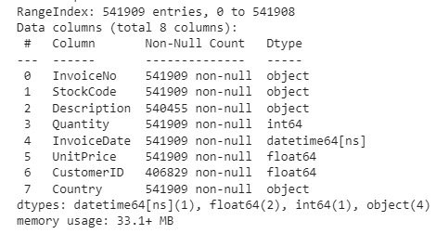
Dataset Information
Dataset Source:
UCI Machine Learning repository’s online-retail dataset
About Dataset:
Related to UK-based and registered non-store online retail
Contains transactions between 01/12/2010 and 09/12/2011

Slide 5
Approaches to calculate CLV
Historical Approach:
Aggregate Model — Calculating CLV by using the average revenue per customer based on historic transactions. This gives us a single value for the CLV.
Cohort Model — Grouping the customers into different groups based on features and calculate the average revenue per cohort. This gives CLV value for each group.
Predictive Approach:
Machine Learning Model — Using regression/classification techniques to fit on past data to predict the CLV.
Probabilistic Model —
It tries to fit a probability distribution to the data and estimates the count of future transactions and monetary value for each transaction.

Slide 6
Professor Feedback (10/04/2021)
Feedback received | Action taken
Search for new datasets | Identified following datasets: CDNOW Global Store dataset and Extended version of the UCI machine learning dataset with retail transactions
Change the approach | We plan to perform: Descriptive analytics Feature engineering Develop a variety of machine learning models and identify the best model for predictive analytics Develop an interactive dashboard showcasing our best model predictions

Slide 7
New Datasets Proposed
CDNOW dataset
http://www.brucehardie.com/datasets/
Global Store dataset
https://data.world/vikas-0731/global-super-store/workspace/file?filename=global_superstore_2016.xlsx
Online Retail II dataset
https://archive.ics.uci.edu/ml/datasets/Online+Retail+II

Slide 8
CDNOW dataset:
CDNOW dataset is about entire purchase history of the CD’s up to the end of June 1998 of the cohort of 23,570 individuals who made their first-ever purchase at CDNOW in the first quarter of 1997.
There are a total of 69,659 rows and four fields: the customer's ID, the date of the transaction, the number of CDs purchased, and the dollar value of the transaction.

Slide 9
Global Store dataset
The Global Super Store data set is a customer centric dataset, which has the data of all the orders that have been place through different vendors and markets.
The dataset set has around 50000 rows and 24 columns.

Slide 10
Online Retail II dataset
This Online Retail II data set contains all the transactions occurring for a UK-based and registered, non-store online retail between 01/12/2009 and 09/12/2011.The company mainly sells unique all-occasion gift-ware.
It is an extension of the Online Retail dataset and has been released recently (in 2019). It contains 1067371 rows

Slide 11


